Slide 1
Financial Data Science
Group 2: Cai Yuxin, Dao Duy Hung, Sumedha Bansal, Vineeta Dawar, Wenyan Liu

Slide 2

Project 1
Vineeta Dawar and Dao Duy Hung

Slide 3
Review the quality of the data, list any potential errors, and propose corrected values. Please list each quality check error and correction applied.
The last 6 value of Signal are 0, maybe due to the last 6 rows will be dropped and the value before that will be used for data analysis.
There is a large outlier of signals (35.43414701) which is almost double the normal value of signal in 11/13/2017. (We can drop the value or we can fill forward)
The Adj close is lower than the other values noticeably (Need more information)
9/7/2017 to 9/22/2017, the valued of close has been filled with Open forward as the value is the same for all those days (139.110001)
3/19/2018, a large outlier of Close value has been found (196.279999), We can filled with the Open for the next day

Slide 4
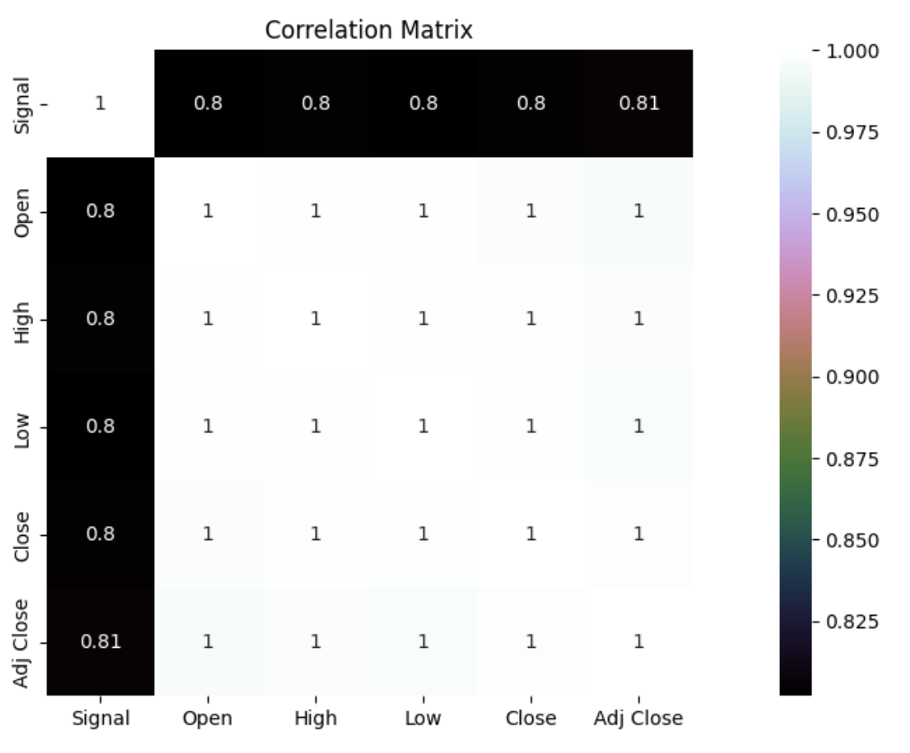
Please analyze the signal’s effectiveness or lack thereof in forecasting ETF price, using whatever metrics you think are most relevant.
At first glance, it appears that the signal does not demonstrate any ability to predict outcomes when tested on a separate set of data (20% of the most recent data). This observation was made by examining a residual plot of the signal against the previous day's open value and the close value.
We also ran the correlation heatmap between the variables
Signal Effectiveness correlation result has been done, where the errors are being measured

Slide 5
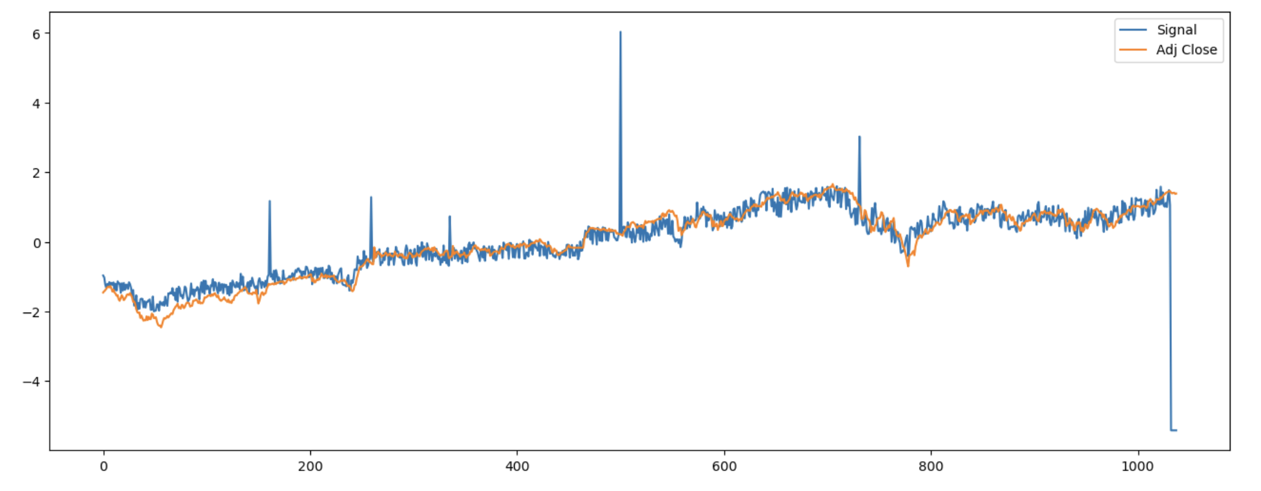
Run any exploratory data analysis you think is important and highlight any interesting insights you come across
Stationarity test has been done (The time series is not stationary)

Slide 6
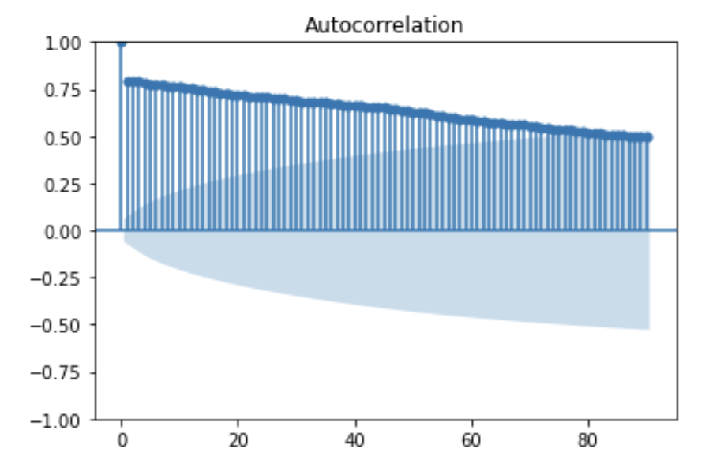
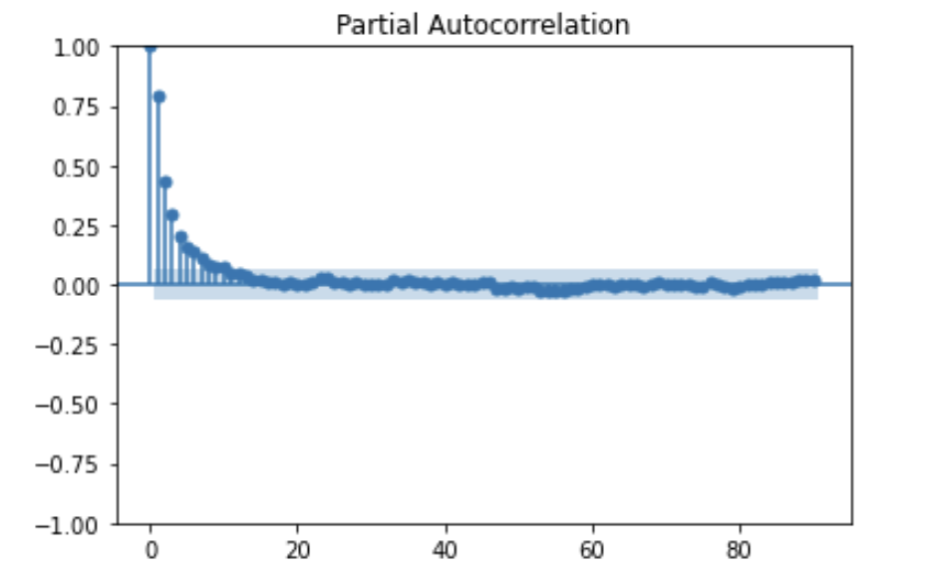
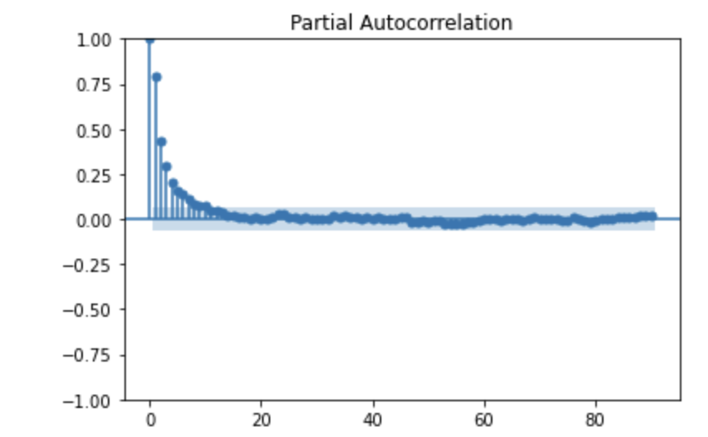
The sample time series is not stationary. ACF and PACF indicates there should be AR process in the closing price series, we could model price with AR(3). No MA process involved.

Slide 7
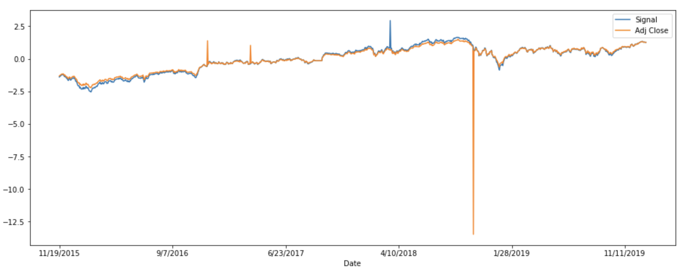
Then we measure the signal and the date together and we can see that they are closely correlated to each other

Slide 8
Write a summary for the team addressing your observations about the efficacy and believability of the product, and recommendation for next steps.
This data shows that the signal data is efficient in predicting the the Adj Close data. Thus it is effective in predicting the price of the ETF
There are some outliers and some errors within the data but they are minor and can be fixed by either dropping the value or fill it forward
From the EDA we can see that there are some volatility pattern with the data but overall there is a slight upward trend.
The strengths of this data set is that it is very detailed and has a lot of days and updated on a daily basis. The weakness is it doesn’t provide enough variables and explanation to predict the ETF price and some of the variables are correlated to each other thus making the time series to be non-stationary. So, there should be further refinement of the signal, additional validation of the data, or integration into production systems.

Slide 9

Project 2 part 1:
Sumedha Bansal

Slide 10
Introduction
The first part of this project includes scraping the data from the website: https://h1bdata.info/, for all companies across all years.
H1b website gives the job data for different companies who issued H1b visa for different roles in their company during the period 2012-2023.
Due to computational issues, we analysed data only for limited number of companies. For scraping the data from this website, packages like BeautifulSoup was utilised. The companies analysed are given in the Jupyter notebook.

Slide 11
Data Preprocessing
Here, we are analysing 50 companies. 25 companies in each jupyter notebook. All this is done in order to reduce computation time and make the analysis easier. The companies are chosen on the basis of the h1b visas they have issued. Top 50 companies are analysed here.
Company’s Name disambiguation: For this process, we are classifying the companies on the basis of their main line of business. There two main categories, technology, investment and others.

Slide 12
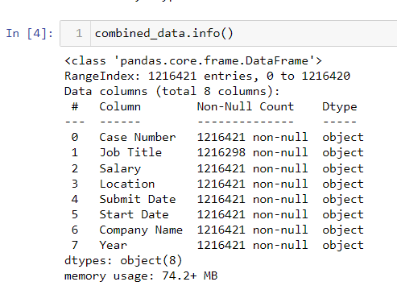
Part 1: Observations
Missing Value: Job title data was missing for 123 companies out of 1.2 million rows. So, we dropped such data to do job title distribution analysis. As it was a very small proportion of the total data, even at company level plus correct imputation of textual data is difficult.
Disambiguation: Because some companies had their names too many times in the list, it was difficult to differentiate between them. So, we categorise them as Tech/Investment/others.
2.

Slide 13
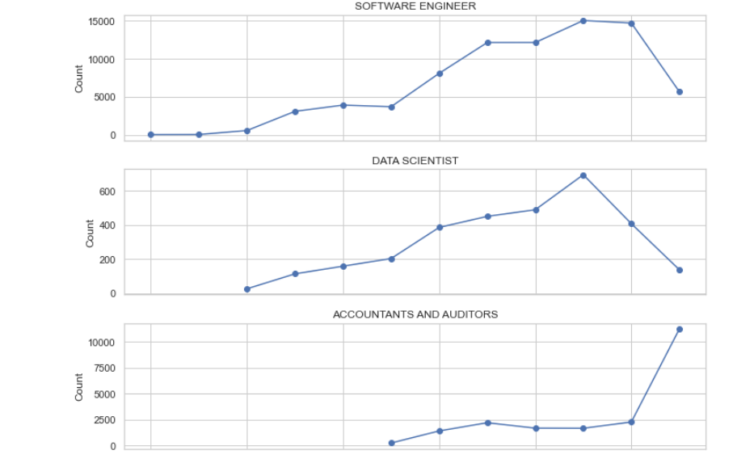
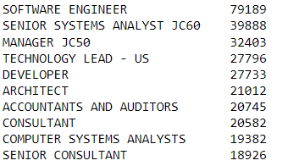
3. Tech VS Investment: Higher proportion of tech companies. Not representative if we are to analyse using categorisation.
4. Job title: We have 25000 unique job with the top ten job shown in the table. This means that on average, companies apply these visas mostly for software engineers.
5.Demand for job roles: In 2022, the demand for engineers dropped while since 2023, the demand for accountants increased. Need more data to confirm this trend.there is sudden drop in software engineers, data scientists filings while increase in accountant.

Slide 14
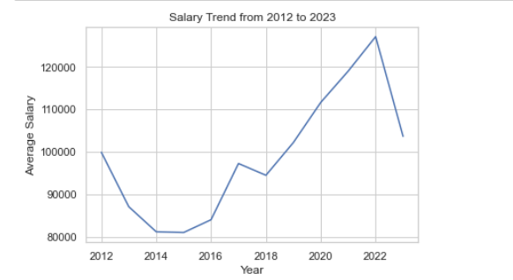
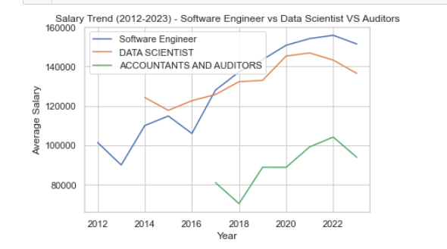
6. Salary Trend: Average salary trend shows a sudden drop despite a rising trend.
7. Costly hires: It has always been costly to hire engineers and data scientists as compared traditional finance roles.
8. Tech vs Investment: Average salaries in tech sector is higher than average salary in finance sector.

Slide 15
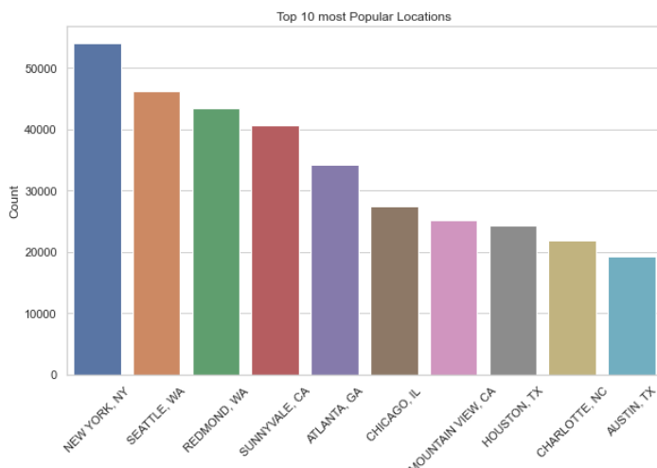
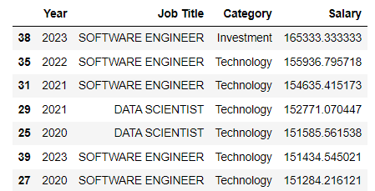
9. Location-wise:Most popular locations, on average, where these companies have a lot of openings.
10. Location-Salary: From our observations, the top locations where highest salaries were paid in 2021 and 2023 are NY, Hoboken and San Francisco. In 2022, San Jose and Mountain view were the ones.
11. Interesting: One interesting observation is that software engineer in Investment firms are paid more than in tech firms assuming our classification is correct.

Slide 16
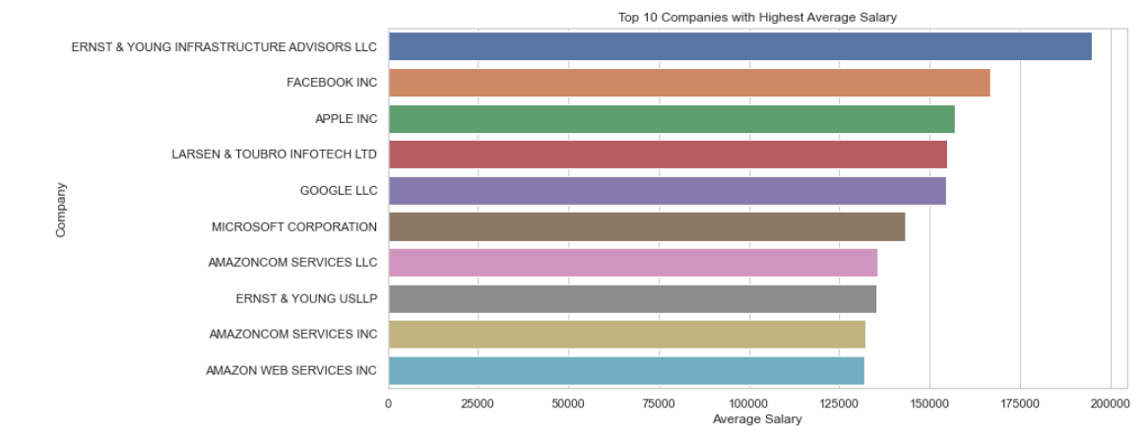
The highest salary is paid by EY, facebook and Apple on average.

Slide 17
Improvement
Combining both parts: We can combine data of both the parts of the project and have a larger and diverse mix where we can properly analyse category wise data.
Remove missing years: Some companies do not have data from 2012. So, we should focus only on companies which all years’ data to ensure better comparison and understanding of trends in various features.
Duration: Finally we can analyse the time it takes across different roles from start and submit data. We can also analyse if there is any significant reduction in this time period.

Slide 18

Project 2 Part 2
Cai Yuxin

Slide 19
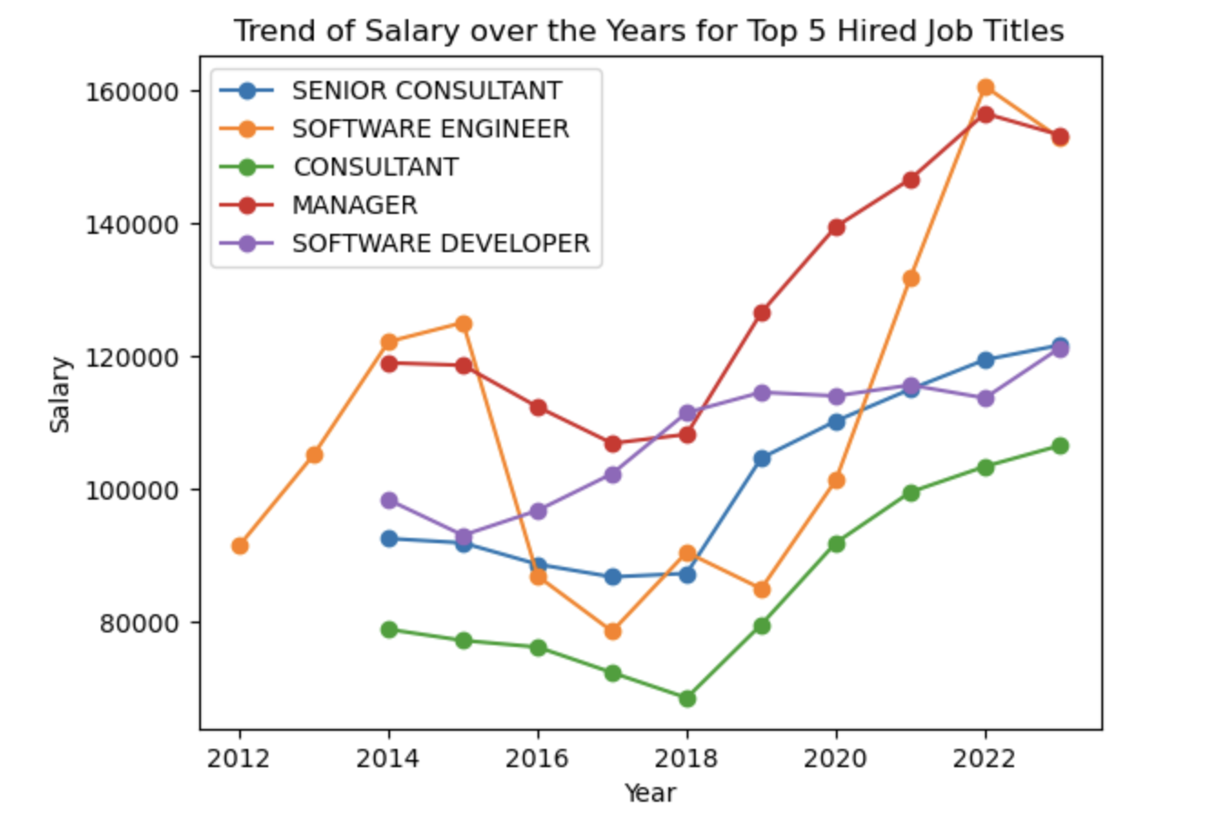
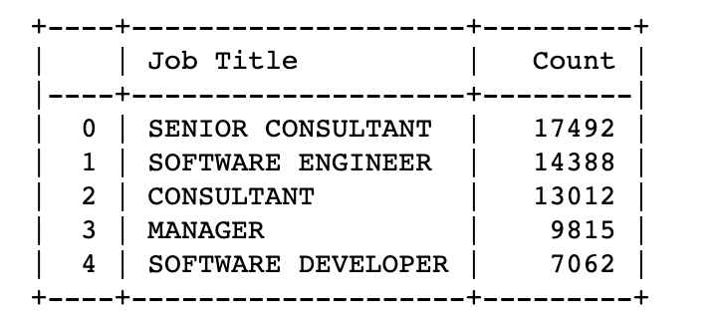
Top 5 hired job and how expensive to hire them

Slide 20
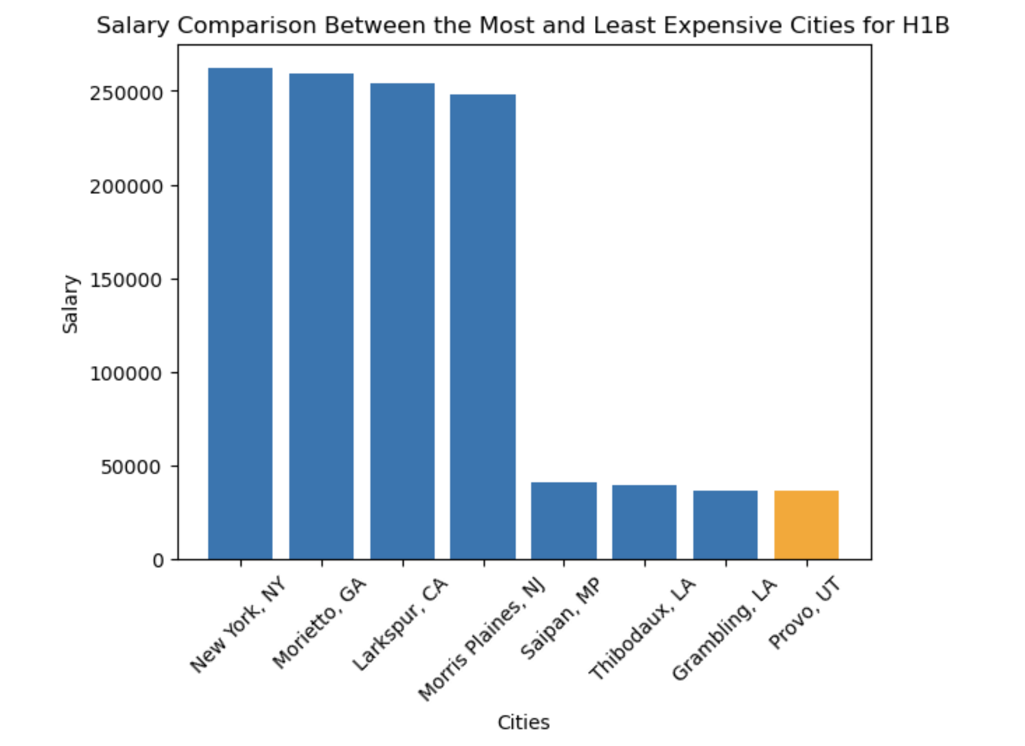
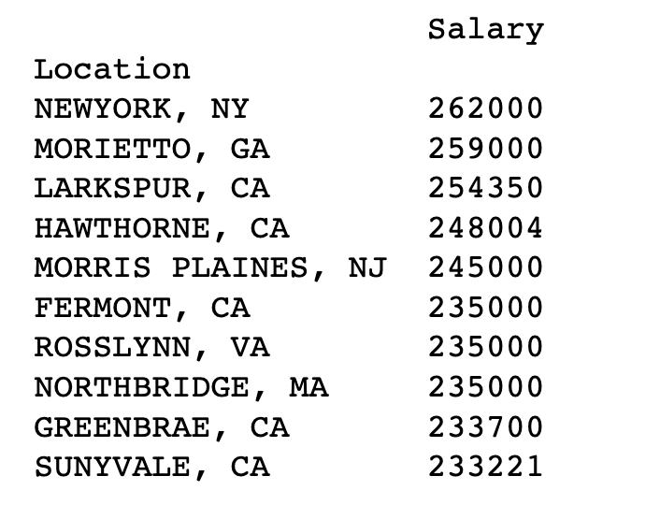
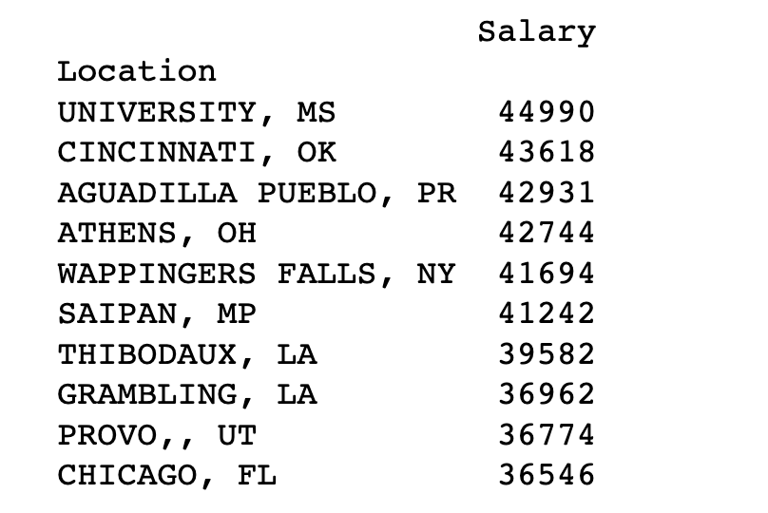
Highest and Lowest Salary Location

Slide 21
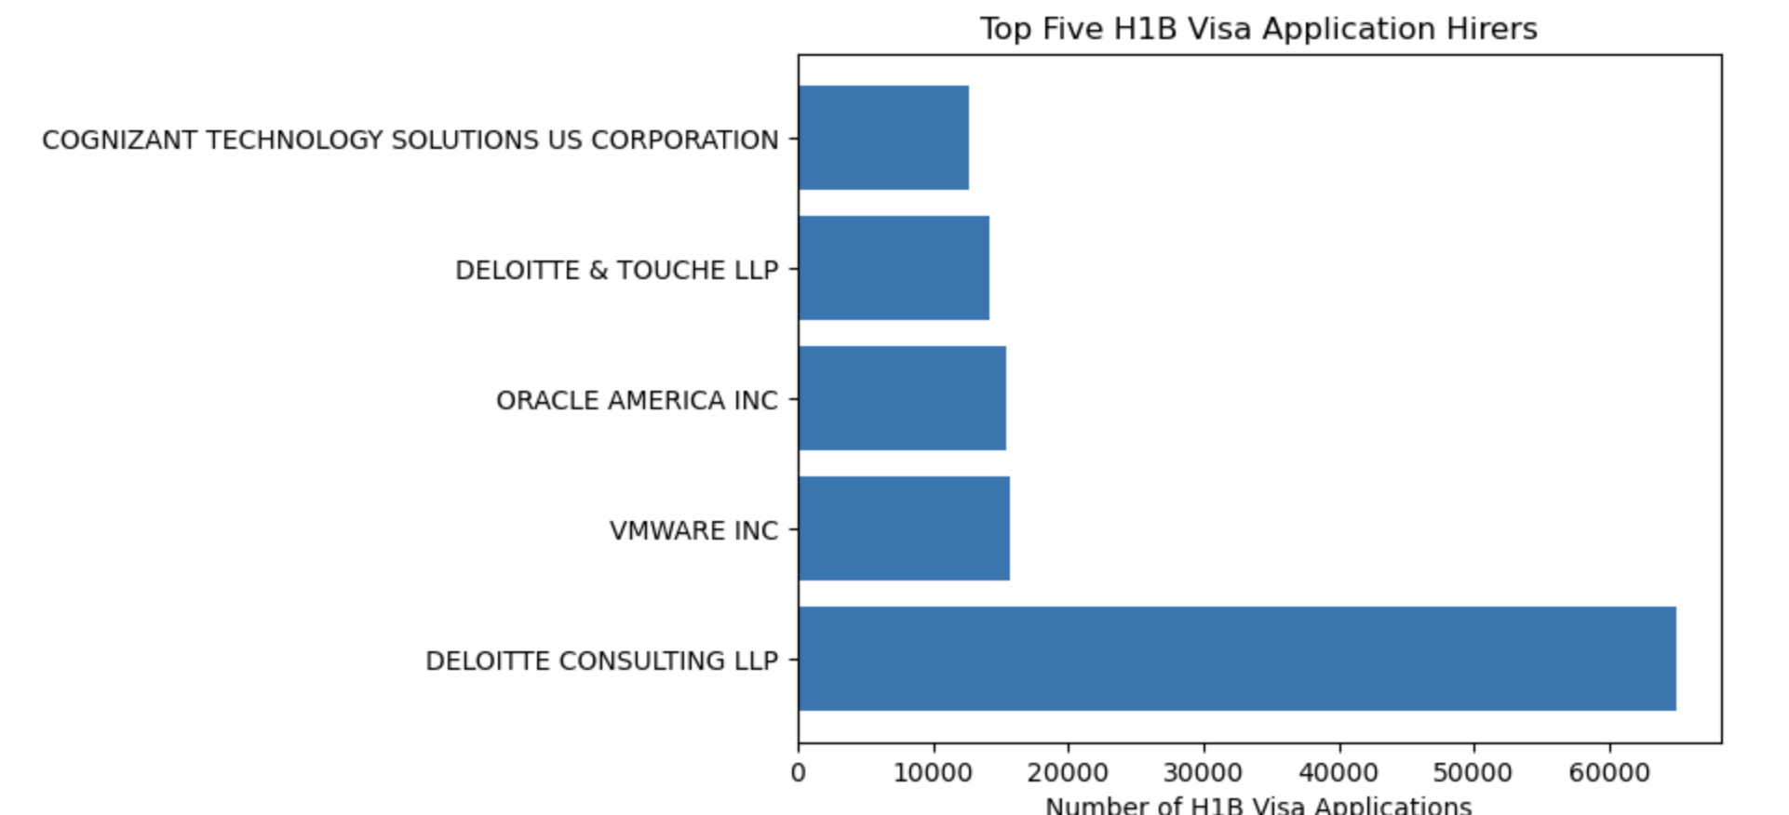
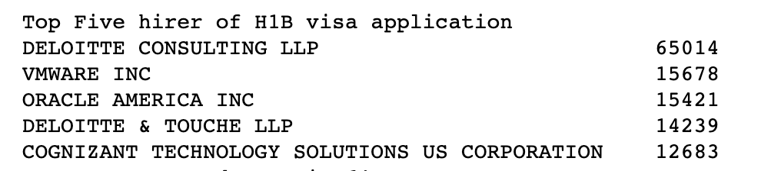
Who is the biggest hirer of H1B visa applicants?

Slide 22
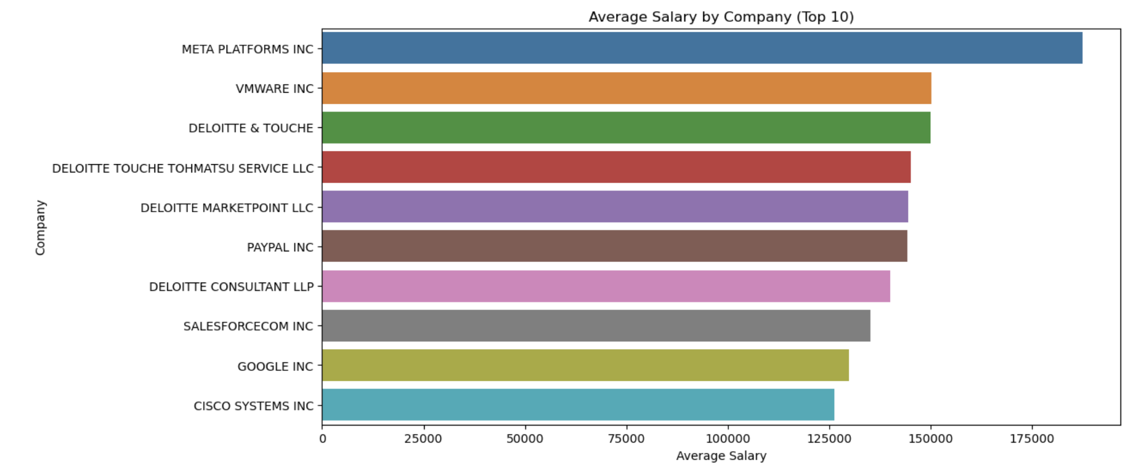
HIghest salary it by META,VMWARE,DELOITTE

Slide 23
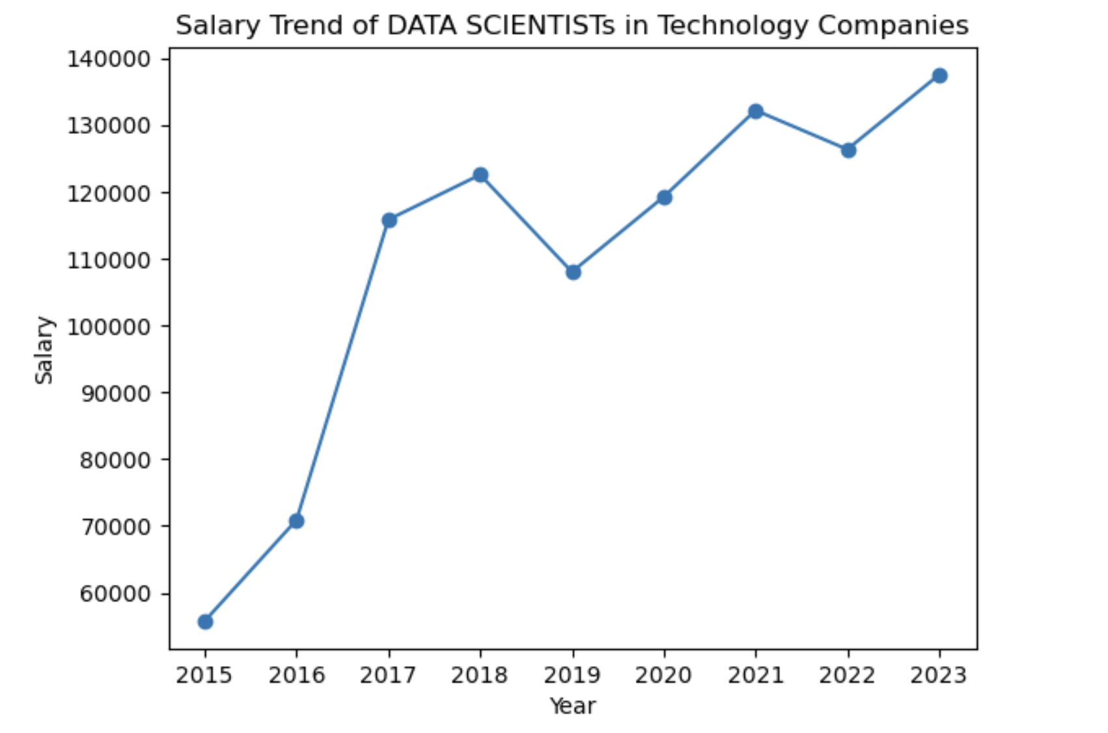
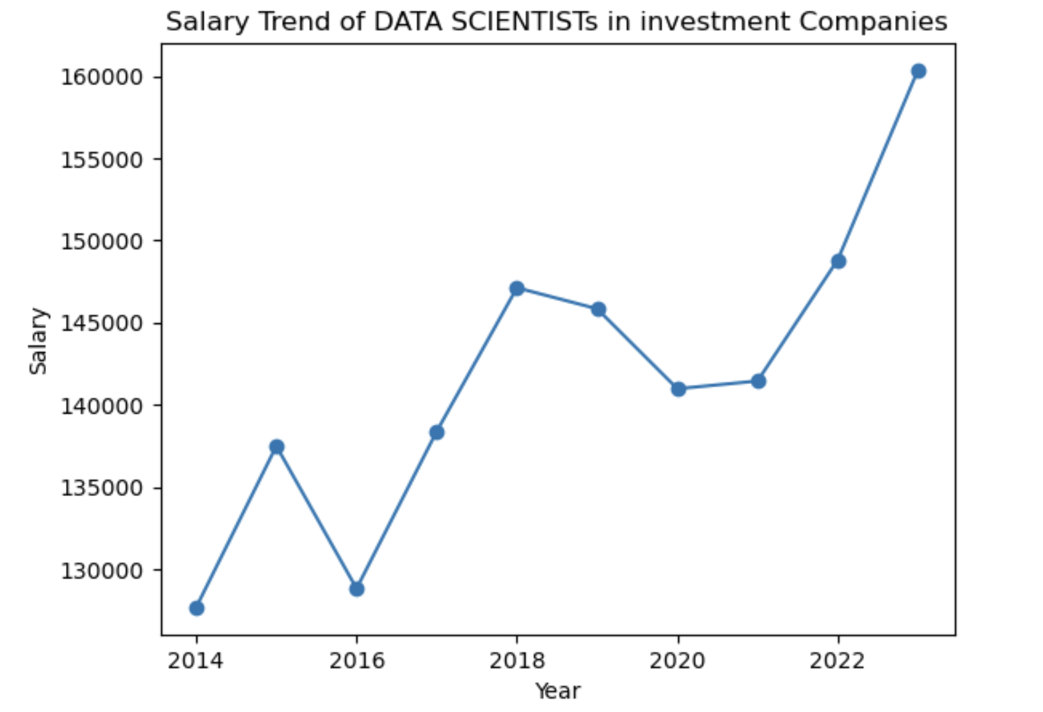
How has the trend of salary for Data scientists been over the years?

Slide 24
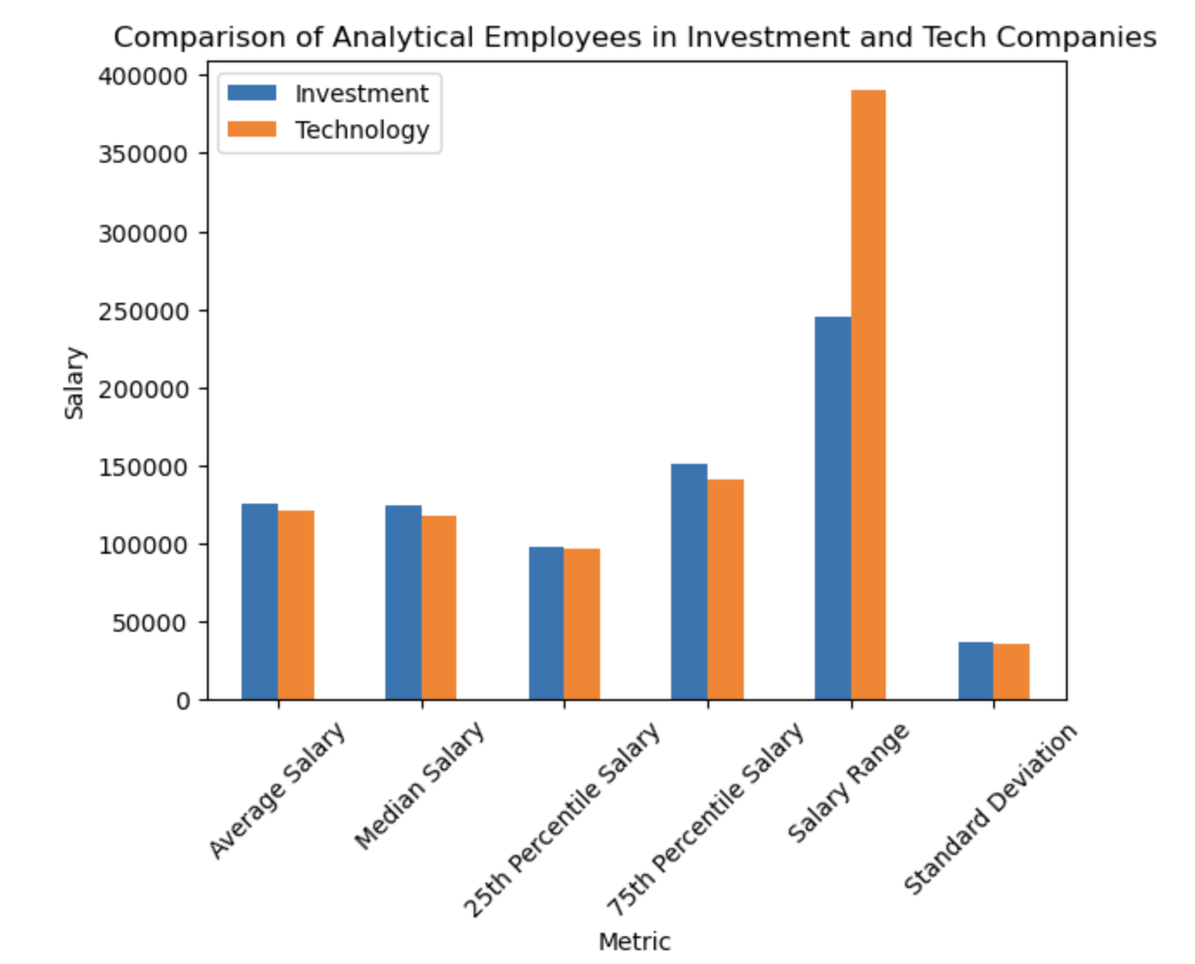
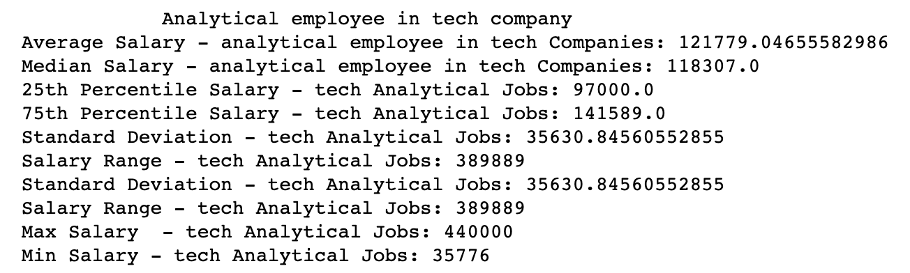
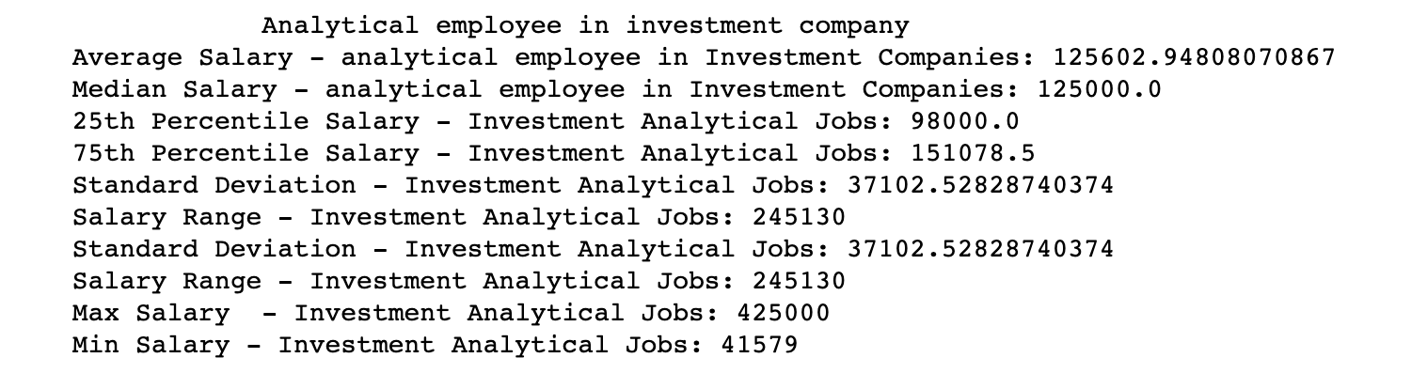
Comparison Analytical job in investment and tech company
analytical_keywords= 'ENGINEER|TECHNICAL|SCIENTIST|ANALYSIS|SCIENCE|DATA｜SPECIALIST

Slide 25
How much more useful will this dataset be if joined with other datasets/metadata?
- Providing context and enabling deeper analysis
- Offering insights into salary trends
- Examining regional variations in salaries
- Identifying inequalities in salary distributions
- Investigating factors that affect salaries
- Merging the dataset with other relevant data sources can provide a more comprehensive and valuable perspective on salary analysis.
What types of data would that be
This includes industry or sector data, location data, company information, employee demographics, and job descriptions and skills data.

Slide 26

Project 3:
Wenyan Liu

Slide 27
Building a Better Company Classification Scheme and Explore Deeper Insights
Company tickers with top 10 analyst coverage are ADS GR, SAP GR, ASML NA, AZN LN, MC FP, EQNR NO, HSBA LN, NOVOB DC, REP SM and NOKIA FH.
Analyst names with top 10 company coverage are Antpagna, Valtadly, Teaerage, Svemeier, Casy Lea, Jannertz, Marchnee, Larbrink, Denolina and Celnnuti.
Clustering based on analyst co-coverage:
We understand this BETTER COMPANY CLASSIFICATION need us to divide companies into different groups in a way considered their analyst co-coverage. Since given dataset with provides the GICS SECTOR and INDUSTRY classification of each company, we need to cluster all these companies with additional ANALYST CO-COVERAGE, based existing two GICS classifiers.

Slide 28
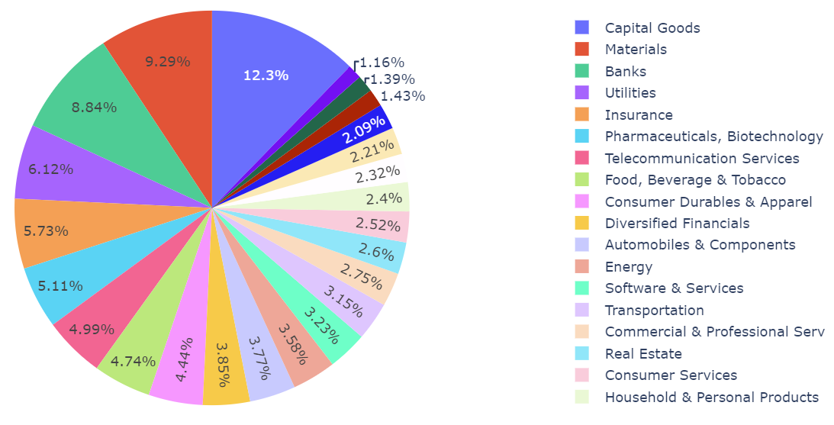
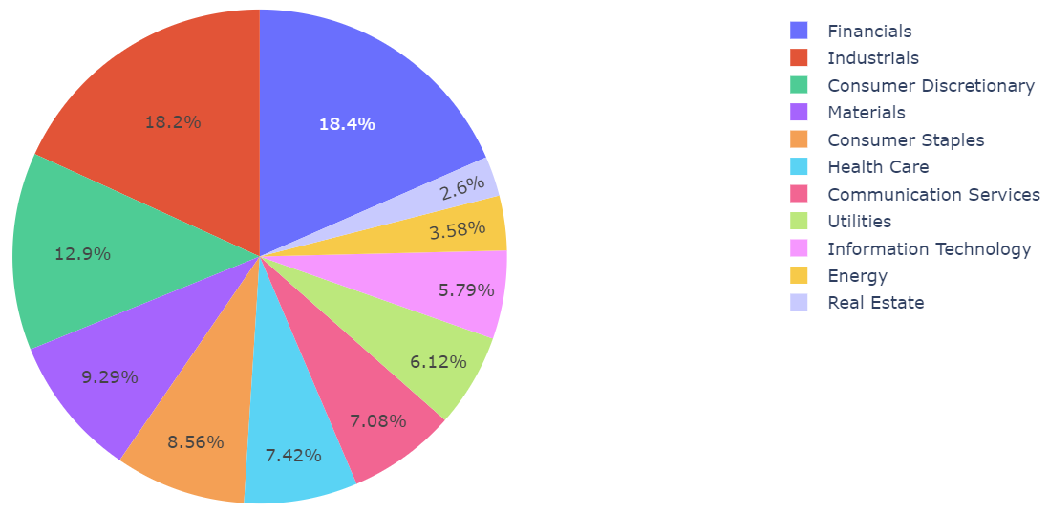
EDA Before Better Company Classification
Sector Coverage
Industry Coverage
$20K
10%
45K
There are total 24 industries.
Most companies is in capital goods industry. The second and third one is Material and Banks respectively. Utilities, technology hardware and food retailing is the industry with only around 1% of total company numbers.
There are total 11 sectors.
Most companies is in financial sector, industrial sector follows. Real estate is the sector with no more than 5% of total company numbers.

Slide 29
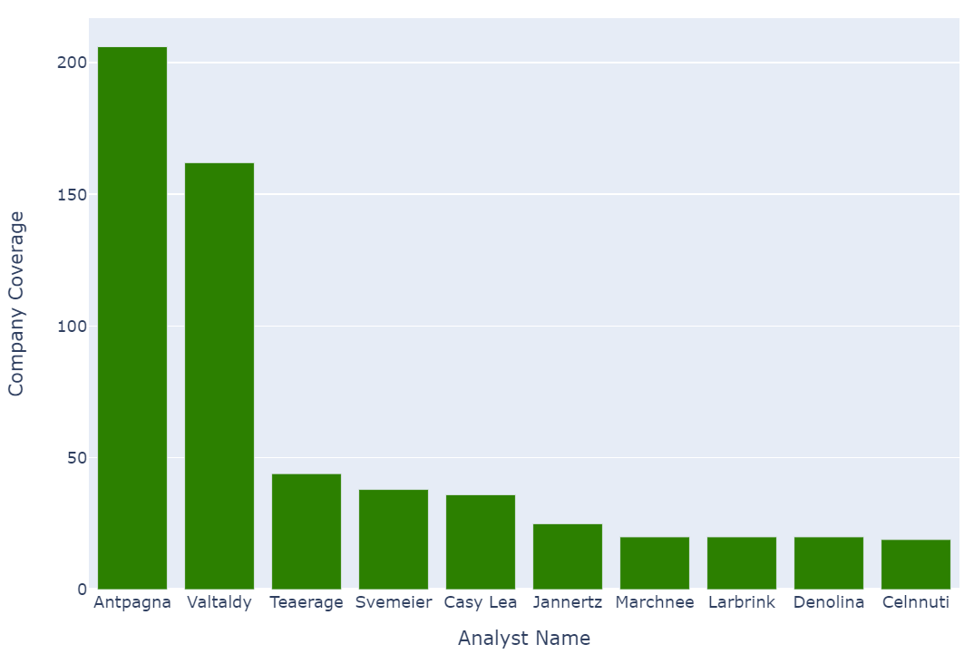
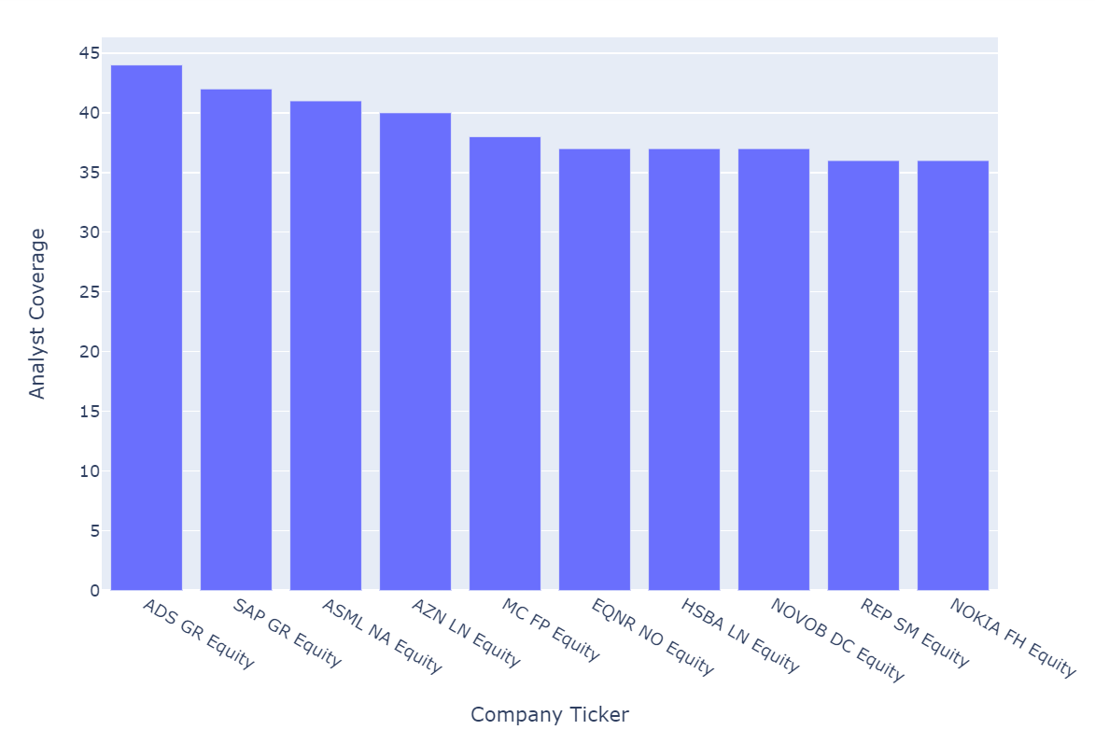
EDA Before Better Company Classification
Analyst with Top 10 Company Coverage
Companies with Top 10 Analyst Coverage

Slide 30
Clustering
01
02
03
04
Label Encoding
Label sector & industry with Label-Encoding method
Optimal Clustering Numbers
Use SSE Metric to see clustering effect with different cluster numbers
Dimension Reduction
Perform t-SNE dimension reduction to 2 dimensions
Clustering Results
Visualize clustering results

Slide 31
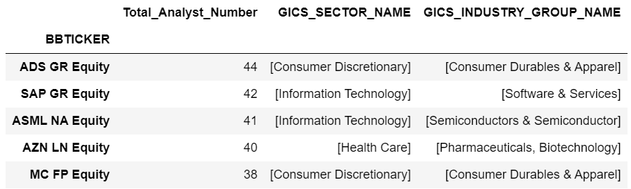
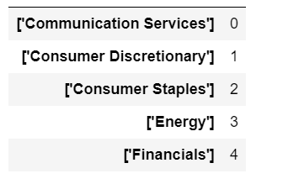
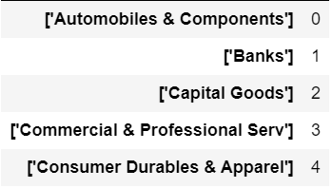
Label Encoding

Slide 32
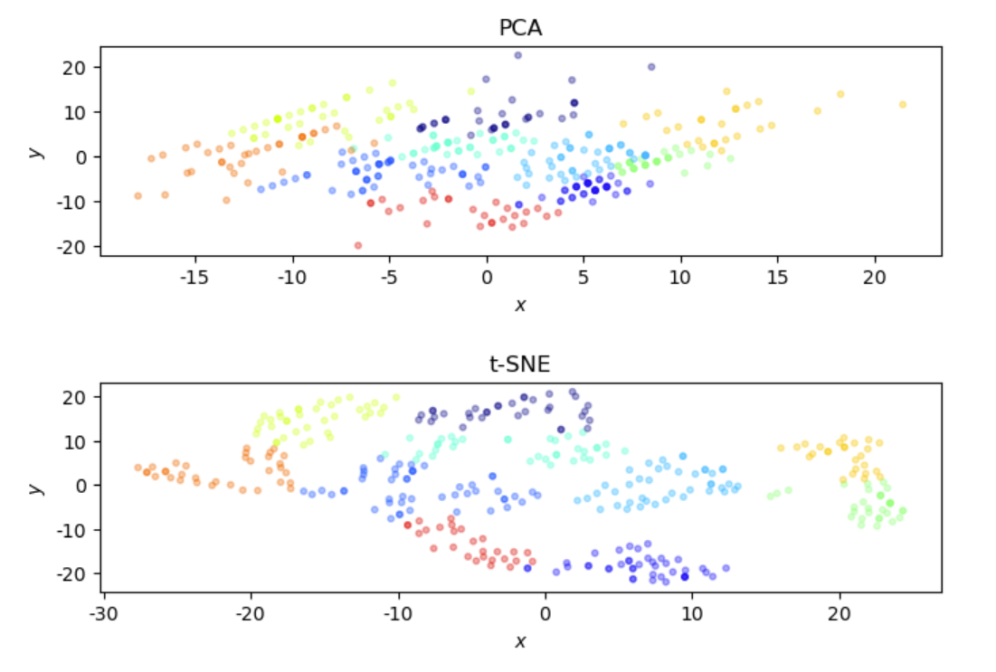
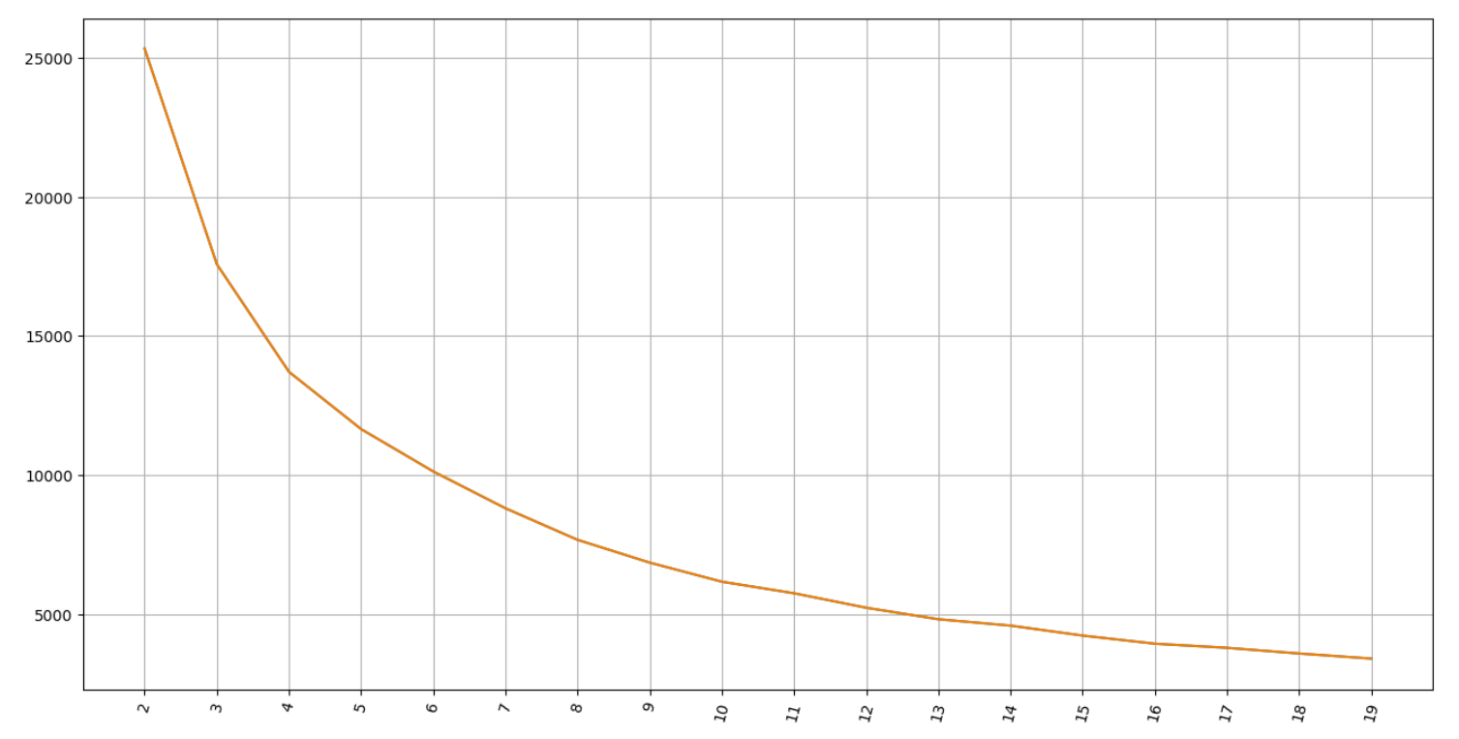
Dimension Reduction Comparison
K-means groups observations into K clusters. Vector quantization assigns each observation to the cluster with the nearest mean or centroid.
It minimise the sum of squared distances between data points and cluster centroids creates internally homogeneous and distinguishable clusters.
In our case, 10 is optimal clustering number.
T-SNE is a nonlinear dimensionality reduction technique by converting distances between data points into conditional probabilities that represent similarities.
In our case, t-SNE works better than PCA. It performs a clean separation of most of data points.

Slide 33
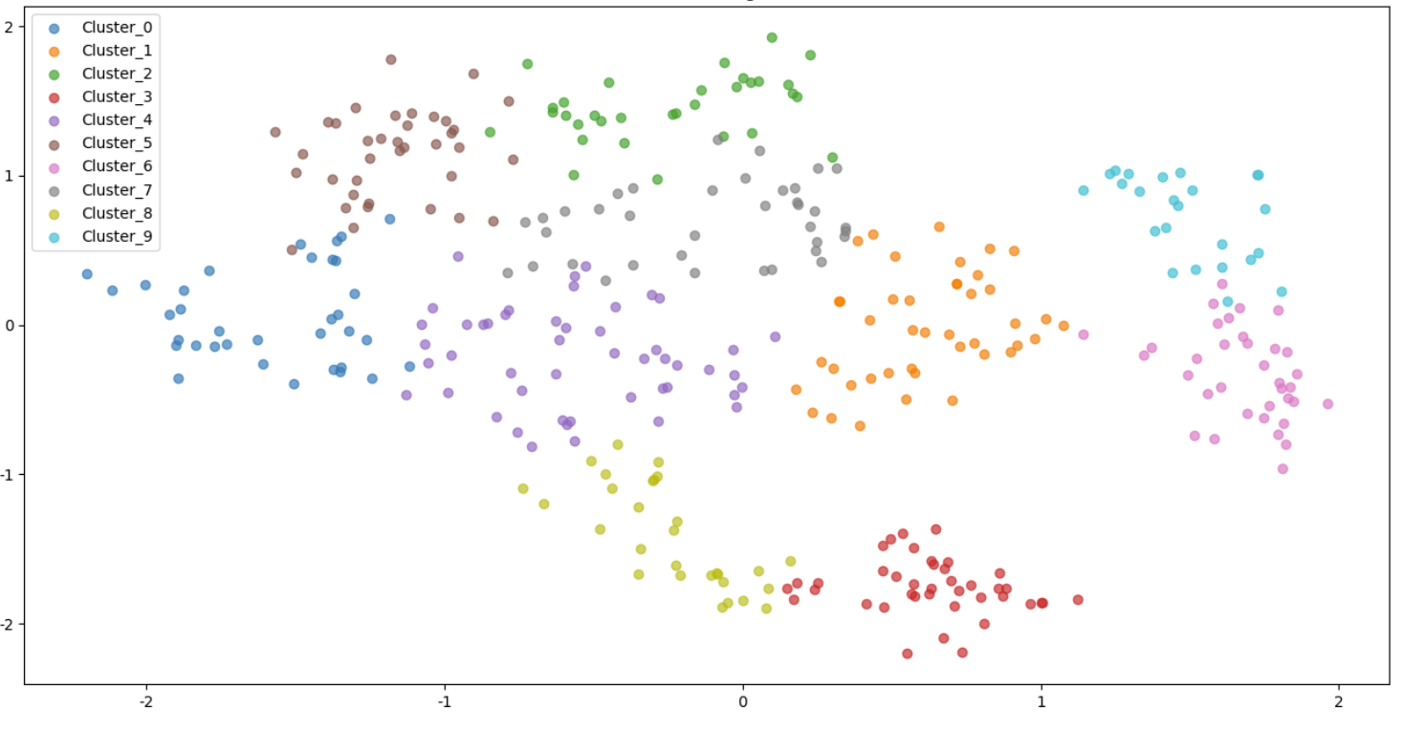
Clustering Results with t-SNE

Slide 34
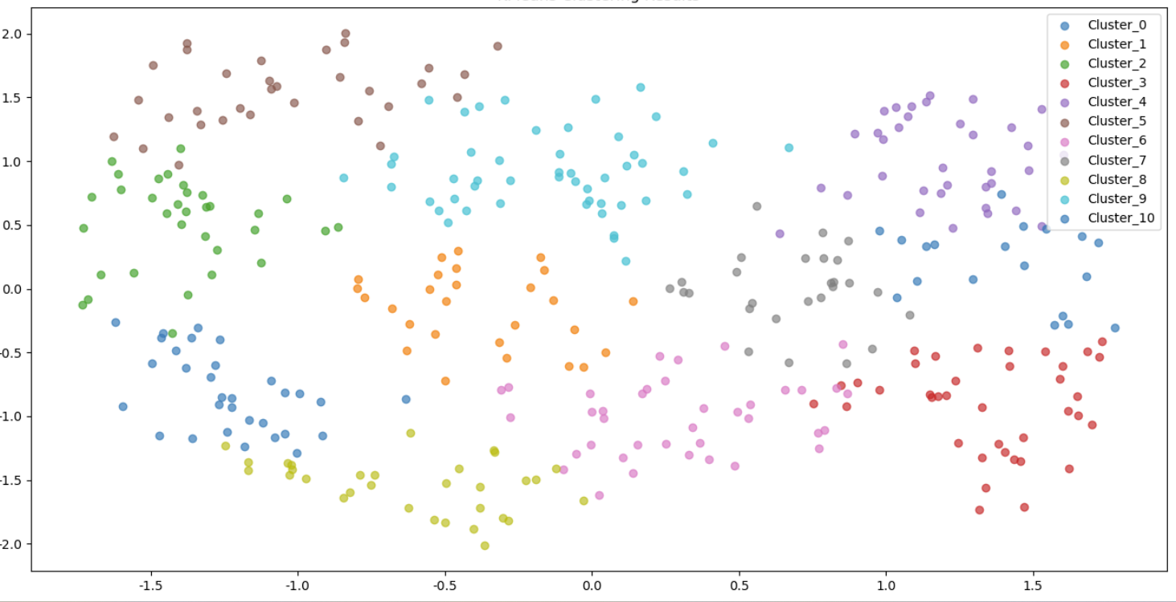
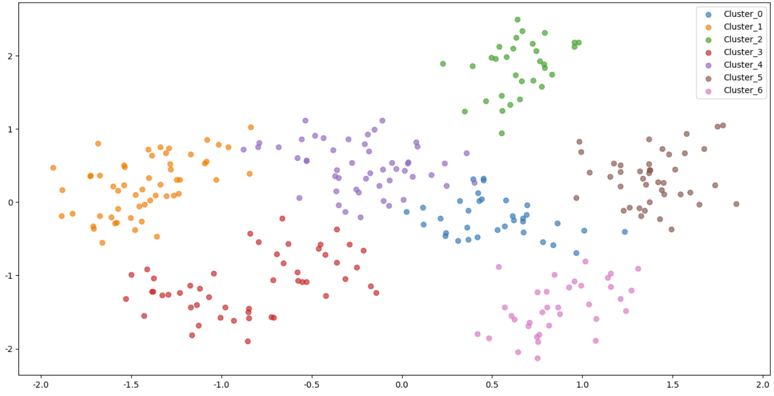
Clustering with Restrictions
With restriction on analysts distribution, we firstly sort out analyst names that only within required standard deviation of distribution found in Q2. Then we follow the same methodology in previous example to model the similarity matrix between companies based on analyst co-coverage.
The first graph shows clustering results with restriction on distribution within 1 standard deviation. The cluster number is almost same as no restrictions, which is 11. But the distance between each company changes and become more dispersed.
The second graph shows clustering results with restriction on distribution within 0.1 standard deviation. With this restriction, cluster number reduces to 7 and distance is even more dispersed.

Slide 35

Thank You For Listening

